Slide 1
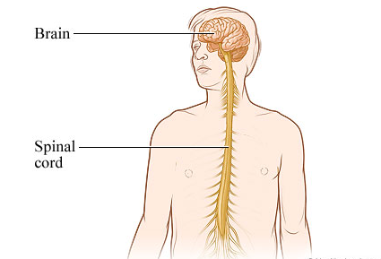
The Central Nervous System (CNS) - protection
Chapter 5 HP

Slide 2
Central Nervous System
Brain and Spinal Cord
Interprets, Coordinates and Integrates
input from sensory nervous system
output to motor nervous system

Slide 3
Protection of CNS
Delicate and Vital
Fragile, does not heal or regenerate well
Heavily Protected
3 structures for protection
Bone
Meninges
Cerebro-Spinal Fluid (CSF)

Slide 4
Protection of CNS
Bone
Cranium (skull) houses the brain
Spinal cord within vertebral canal in vertebrae
Meninges
3 layers of connective tissue
Between bone and CNS
Fibrous outer layer
Loose mesh middle layer
Delicate inner layer
Blood vessels
Sticks closely to surface of brain, and spinal cord

Slide 5
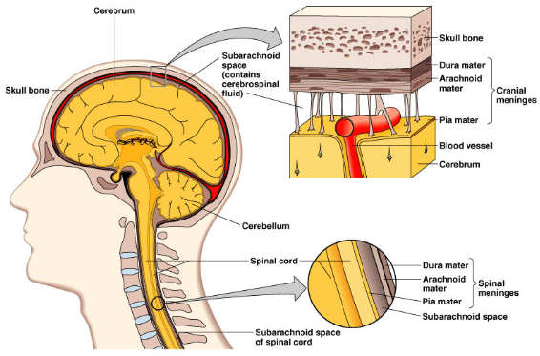

Slide 6
Protection of CNS
Cerebrospinal Fluid (CSF)
3 functions:
Protection
Support
Transport
Between middle and inner layers of meninges
Circulates through cavities in brain and canal in spinal cord
Clear, watery fluid:
Few cells
Glucose, protein, urea, salts
Shock absorber, supports fragile brain tissue
Formed from blood, circulates and eventually re-enters blood.
Barrier between blood vessels and CSF is quite tight
Protects against entry of bacteria, and some other particles
Transports nutrients and wastes to cells of brain and spinal cord

Slide 7
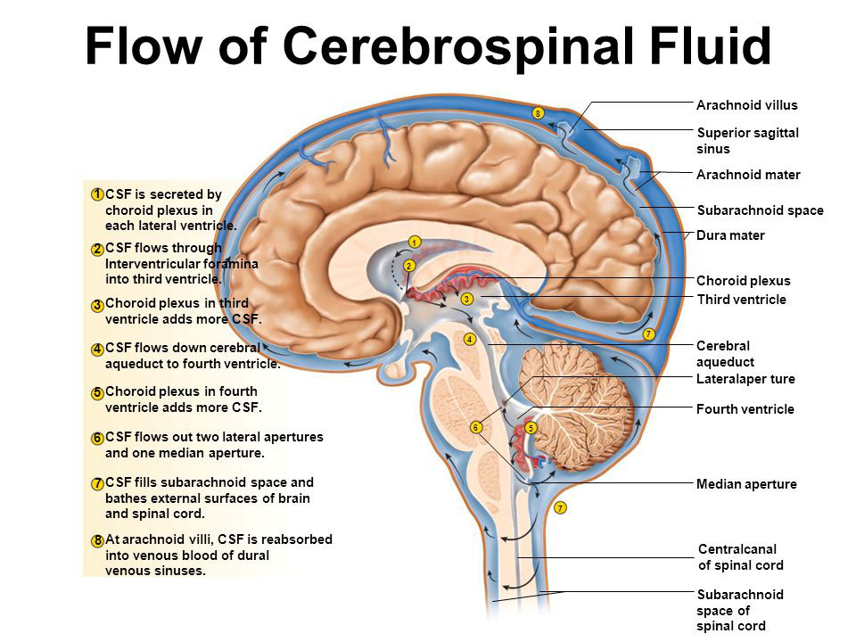
Information Only: This is more detail than you need to know.

Slide 8
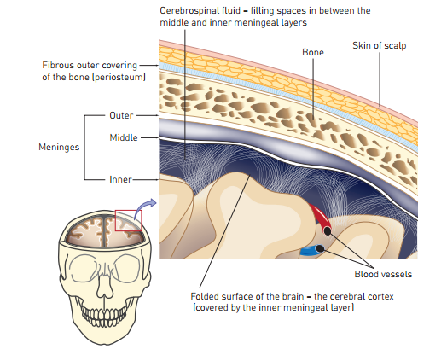

Slide 9
